Slide 1
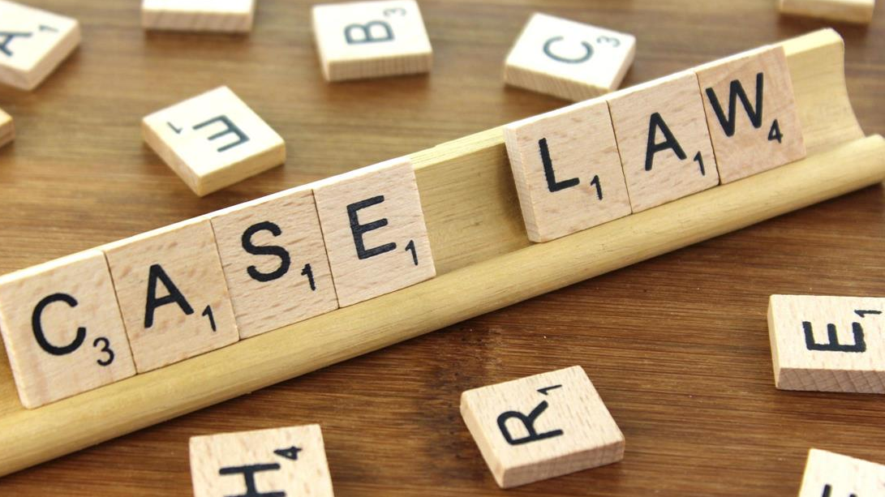
Bail and the Law
Legal Challenges to the Money Bail System

Slide 2
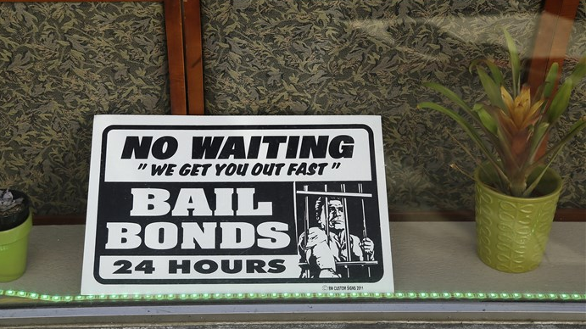
“Cash Bail, a Centerpiece of the Justice System, Is Facing Its Undoing”
https://www.nbcnews.com/news/us-news/cash-bail-centerpiece-justice-system-facing-its-undoing-n669206

Slide 3
Caliste et al. v. Cantrell (LA)
Commonwealth v. Wagle (MA)
Welchen v. Sacramento (CA)
Buffin v. San Francisco (CA)
Martinez v. City of Dodge City (KS)
Snow v. Ascension Parish (LA)
Cooper v. City of Dothan (AL)
Thompson v. Moss Point (MS)
Powell v. City of St. Ann (MS)
Pierce v. City of Velda City (MO)
Varden v. City of Clanton (AL)
Walker v. City of Calhoun (GA)
Mock et al v. Glynn County (GA)
Kunkeli v. Anderson (NY)
Howard v. City and County of Denver (CO)
In re Kenneth Humphrey (CA)
Robinson v. Martin (IL)
Hester v. Gentry (AL)
Daves v. Dallas County (TX)
O’Donnell v. Harris County (TX)
Little v. Frederick (LA)
Edwards v. Cofield (AL)
Dixon v. City of St. Louis (MO)
Targa v. Tulsa County (OK)
Ross v. Blount (MI)
Booth v. Galveston County (TX)
Philadelphia Bail Fund v. Bernard (PA)
Hiskett v. The Honorable Rick Lambert (AZ)*
Still v. El Paso County (CO)

Slide 4
Results
Dismissal following defendant’s agreement to end or amend certain practices, like the use of financial bail
Declaratory Relief or Injunctions
Fees and costs. In Harris County:
$3,725,231.00 in fees and $114,832.54 in costs to Civil Rights Corps;
$2,161,262.00 in fees (to be forgone) and $30,214.86 in costs to Susman Godfrey L.L.P.;
$632,453.00 in fees to Wilmer Cutler Pickering Hale and Dorr LLP; and
$182,715.90 in fees and $5,378.00 in costs to the Texas Fair Defense Project.

Slide 5
“Poor people in Detroit are routinely jailed because they cannot afford bail. Meanwhile, similarly situated individuals who can afford bail are routinely released. This unnecessary, unconstitutional, and costly discrimination against indigent people accused of crimes in Detroit is the result of the 36th District Court’s policy and practice of making no inquiry whatsoever into an arrestee’s ability to pay before imposing bail requirements.” UNITED STATES DISTRICT COURT FOR THE EASTERN DISTRICT OF MICHIGAN, SOUTHERN DIVISION Case 2:19-cv-11076-LJM-EAS ECF No. 1 (04/14/19)

Slide 6
Major Issues Addressed
Bail decisions are release decisions
Reasonable bail must:
Consider the defendant’s ability to pay
Be individualized to the defendant’s risk
Not be charge-based
Bail schedules are unconstitutional
Due Process guarantees apply in the application of preventive detention.
Bail conditions must be tied to court appearance or public safety. Conditions imposing financial cost to the defendant may be illegal.
Jurisdictional resources are no excuse to deny rights associated with bail

Slide 7
Bail Decisions=Release Decisions
Bail Equals Release and No Bail Equals Detention. If a person fails to gain release as a result of a financial condition, that is unintended preventive detention. Preventive detention without due process is unconstitutional. Therefore using financial bail as a method to detain defendants without a detention hearing is unconstitutional Tim Schnacke: Fundamentals of Bail: A Resource Guide for Pretrial Practitioners and a Framework for American Pretrial Reform

Slide 8
Bail Decisions=Release Decisions
After its review, the Supreme Court found that defendant presented the district court with uncontroverted evidence demonstrating that nonmonetary conditions of pretrial release were sufficient to reasonably assure that Defendant was not likely to pose a flight or safety risk. Despite this evidence, the district court ordered that Defendant be held in jail unless he posted a $250,000 cash or surety bond, based solely on the nature and seriousness of the charged offense. The Court concluded that the district court erred by requiring a $250,000 bond when the evidence demonstrated that less restrictive conditions of pretrial release would be sufficient. The Court therefore reversed the district court’s pretrial release order and instructed the district court to release Defendant on appropriate nonmonetary conditions. CASE SUMMARY, STATE V. BROWN NEW MEXICO SUPREME COURT CASE NO. 34,531

Slide 9
Reasonable Bail: Ability to Pay
“While imposing bail under appropriate circumstances clearly serves an important and perhaps even compelling governmental objective, the failure to consider the economic status of a defendant does not serve that interest nor does the consideration of economic status impede that interest." PEOPLE OF NEW YORK V. ANDERSON INDEX NO. 90/2018 SUPREME COURT OF NEW YORK, COUNTY OF DUTCHESS

Slide 10
Reasonable Bail: Ability to Pay
“No person may, consistent with the Equal Protection Clause of the Fourteenth Amendment to the United States Constitution, be held in custody after an arrest because the person is too poor to post a monetary bond. If the government generally offers prompt release from custody after arrest upon posting a bond pursuant to a schedule, it cannot deny prompt release from custody to a person because the person is financially incapable of posting such a bond.” PEIERCE V. CITY OF VELDA CITY CASE NO. 4:15 CV-00570 MISSOURI EASTERN DISTRICT COURT

Slide 11
Reasonable Bail: Charged-based Decisions
“Neither the Constitution nor our rules of criminal procedure permit a judge to base a pretrial release decision solely on the severity of the charged offense. Bail is not pretrial punishment and is not to be set solely on the basis of an accusation of a serious crime. As the United States Supreme Court has emphasized, “[t]o infer from the fact of indictment alone a need for bail in an unusually high amount is an arbitrary act.” Stack v. Boyle, 342 U.S. at 6. (Rule 5-401) requires the judge to make an informed, individualized decision about each defendant and does not permit the judge to put a price tag on a person’s pretrial liberty based solely on the charged offense.” STATE V. BROWN CASE NO.: 931 P.2d 69 (1996) SUPREME COURT OF NEW MEXICO

Slide 12
Bail Schedules
“The evidence demonstrates that the Sheriff’s use of the Bail Schedule significantly deprives plaintiffs of their fundamental right to liberty, and a plausible alternative exists which is at least as effective and less restrictive for achieving the government’s compelling interests in protecting public safety and assuring future court appearances. Operational efficiency based upon a bail schedule which arbitrarily assigns bail amounts to a list of offenses without regard to any risk factors or the governmental goal of ensuring future court appearances is insufficient to justify a significant deprivation of liberty.” BUFFIN, ET AL. v. CITY AND COUNTY OF SAN FRANCISCO, ET. AL. CASE NO. 15-cv-04959-YGR UNITED STATES DISTRICT COURT NORTHERN DISTRICT OF CALIFORNIA

Slide 13
Due Process-Equal Protection
“In sum, the essence of the district court’s equal protection analysis can be boiled down to the following: take two misdemeanor arrestees who are identical in every way—same charge, same criminal backgrounds, same circumstances, etc.—except that one is wealthy, and one is indigent. Applying the County’s current custom and practice, with their lack of individualized assessment and mechanical application of the secured bail schedule, both arrestees would almost certainly receive identical secured bail amounts. One arrestee is able to post bond, and the other is not. As a result, the wealthy arrestee is less likely to plead guilty, more likely to receive a shorter sentence or be acquitted, and less likely to bear the social costs of incarceration. The poor arrestee, by contrast, must bear the brunt of all of these, simply because he has less money than his wealthy counterpart. The district court held that this state of affairs violates the equal protection clause, and we agree.” O’DONNELL V. HARRIS COUNTY CASE NO. No. 18-20466 (2018) UNITED STATES COURT OF APPEALS FOR THE FIFTH DISTRICT

Slide 14
Due Process Protection-Detention
The Government must: demonstrate probable cause to believe that the charged crime has been committed by the arrestee, in a full-blown adversary hearing, convince a neutral decisionmaker by clear and convincing evidence that no conditions of release can reasonably assure the safety of the community or any person. Prove its case by clear and convincing evidence. Detainees have a right to counsel at the detention hearing. They may testify in their own behalf, present information by proffer or otherwise, and cross-examine witnesses who appear at the hearing. The judicial officer is guided by statutorily enumerated factors (the nature and the circumstances of the charges, the weight of the evidence, the history and characteristics of the putative offender, and the danger to the community). The judicial officer must include written findings of fact and a written statement of reasons for a decision to detain. Decision is eligible for immediate appellate review. U.S. V. SALERNO 481 U.S. 739 (1987). UNITED STATES SUPREME COURT

Slide 15
Due Process Protection-Detention
“As we will explain, although the prosecutor presented no evidence that non-monetary conditions of release could not sufficiently protect victim or public safety, and the trial court found petitioner suitable for release on bail, the court's order, by setting bail in an amount it was impossible for petitioner to pay, effectively constituted a sub rosa detention order lacking the due process protections constitutionally required to attend such an order.” IN RE HUMPHREY CASE NO A152056 CALIFORNIA COURT OF APPEALS

Slide 16
Appropriate Bail Conditions
No pretrial bail system can prevent every defendant who is released on money bail or personal bond from committing an offense or failing to appear. The amici’s argument is essentially an argument for incarcerating every arrestee and defendant until trial or other disposition. That is not and has not been our law. Every American bail system must comply with the Constitution, which presumes innocence and eligibility for pretrial release. The amici’s hindsight disagreements with individual case outcomes have no bearing on whether the decree is a fair, reasonable, and adequate remedy for the constitutional violations that the record shows prevailed in Harris County. O’DONNELL V. HARRIS COUNTY CASE NO. No. 18-20466 (2018) UNITED STATES COURT OF APPEALS FOR THE FIFTH DISTRICT

Slide 17
Appropriate Bail Conditions
A court can't put a person in jail simply because they can't afford to either make bail or pay monitoring fees. In the Mohave County case, the judge required GPS monitoring for the defendant solely because of state legal requirements, not because the person was considered a flight risk. Hiskett v. Lambert CASE NO. CR1 08 22 2019

Slide 18
Appropriate Bail Conditions
“As applied to this defendant at this time, the Adam Walsh Act’s mandatory condition of electronic monitoring is excessive. The government interest in protecting society is valid. Its response in this particular case is not... The defendant poses no risk to society in general, or to children specifically. He has abided fully by requirements for mental health counseling, even giving lectures on sexual abuse. He has followed the strict rigors of home detention. Under these circumstances, this court finds that electronic monitoring is excessive, as applied to this defendant, “in light of the perceived evil.” UNITED STATES V. POLOUIZZI CASE NO. 697 F. Supp. 2d 381, 395 UNITED STATES DISTRICT COURT, EASTERN DUSTRICT OF NEW YORK

Slide 19
Local Resources
“We are not blind to the practical problems our ruling may present. The timelines within which bail determinations must be made are short, and judicial officers and pretrial service agencies are already burdened by limited resources… Nevertheless, the highest judicial responsibility is and must remain the enforcement of constitutional rights, a responsibility that cannot be avoided on the ground its discharge requires greater juridical resources than the other two branches of government may see fit to provide. Judges may, in the end, be compelled to reduce the services courts provide, but in our constitutional democracy the reductions cannot be at the expense of presumptively innocent persons threatened with divestment of their fundamental constitutional right to pretrial liberty.” IN RE HUMPHREY CASE NO A152056 CALIFORNIA COURT OF APPEALS

Slide 20
“Lessons Learned”
Reiteration that bail decisions are release decisions
Reminder that the proper definition of bail includes what is reasonable to assure appearance and safety but also what is within the defendant’s means.
Bail based solely on charge is illegal.
Legal detention must include due process guarantees and appealable decisions.
No jurisdiction is too resource-strapped to afford its citizens justice.

